Slide 1

Liver Disease Prediction
Group: 6
Mentors : Varun , Mounika

Slide 2

Team members
Vivek
D.Sheshidhar Reddy
Yathindra Timmiri

Slide 3
Objective
The variable to be predicted is categorical (no disease, suspect disease,
hepatitis c, fibrosis, cirrhosis). therefore, this is a classification.

Slide 4
Project architecture / project flow
Data collection
Data processing
EDA(Visualizations)
Feature Engineering
Model building
Evaluate & compare performance
Deployment

Slide 5
Data collection

Slide 6
Dataset
the number of instances (rows) in the data set is 615, and the number of variables (columns) is 13. nearly all input variables are numeric-valued except one, sex, which is binary, and most of them represent measurements from blood and urine analysis. the following list summarizes the variables information.
category(diagnose): no disease, suspect disease, hepatitis c, fibrosis or cirrhosis.

Slide 7
EDA(Visualizations)

Slide 8
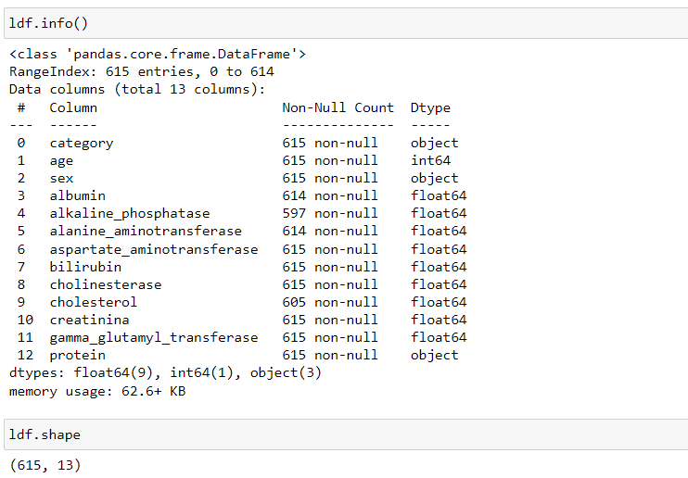
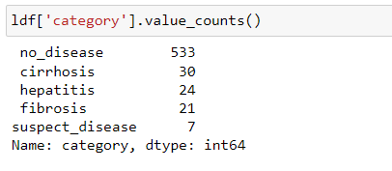
OVERVIEW

Slide 9
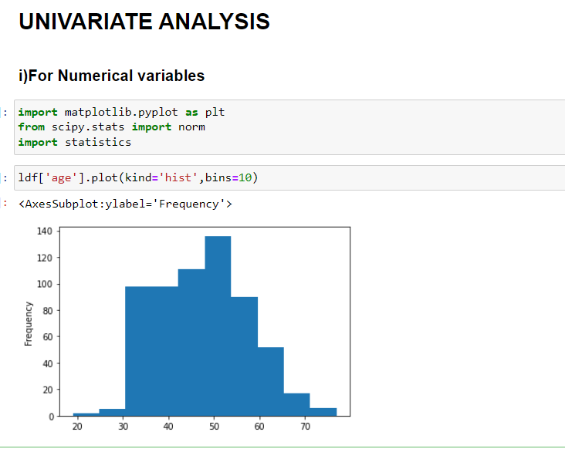
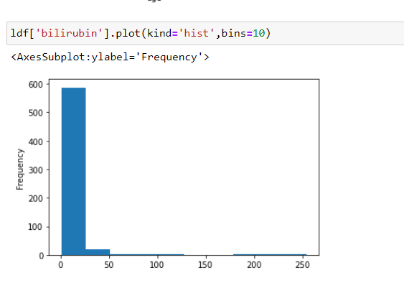
most of the patients are in age between 30-60
More number of people are having bilirubin content b/w 0-30

Slide 10
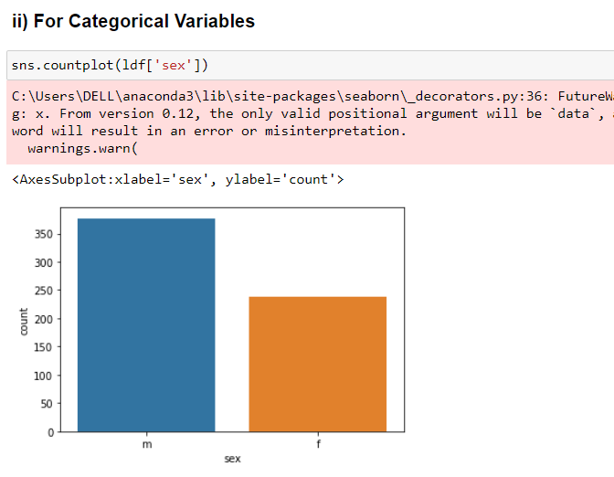
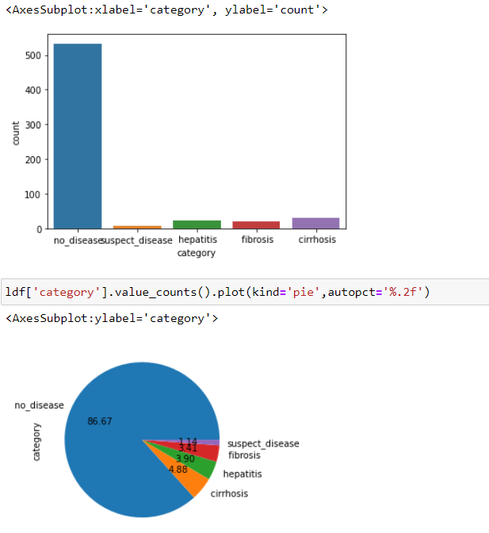
Around 400 people are male and 230 are female
86.67% have no disease, 1.14%have suspect disease,3.41 % have fibrosis,
3.90 % have hepatitis and 4.88 % have cirrhosis.

Slide 11
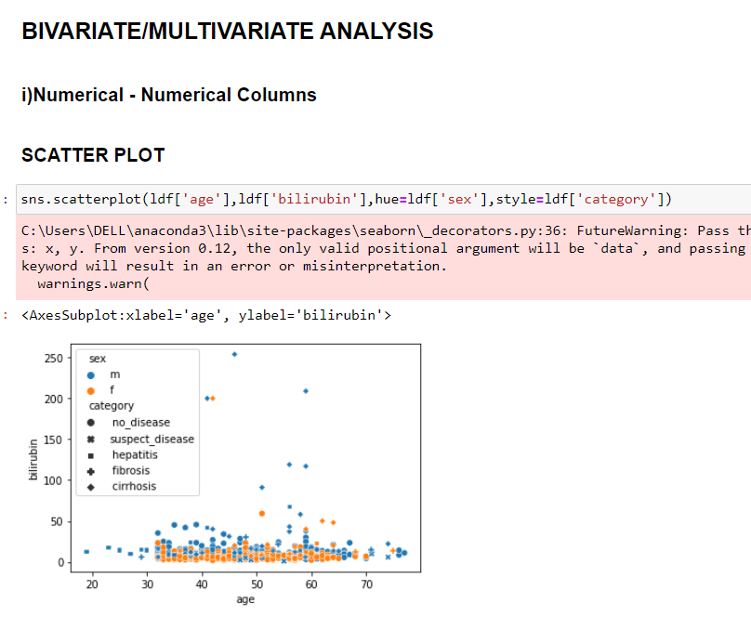
this is the multivariate analysis b/w sex and category columns w.r.t their ages.

Slide 12
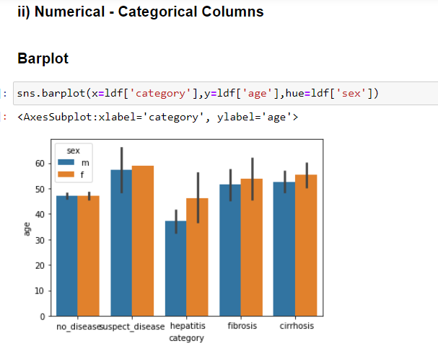
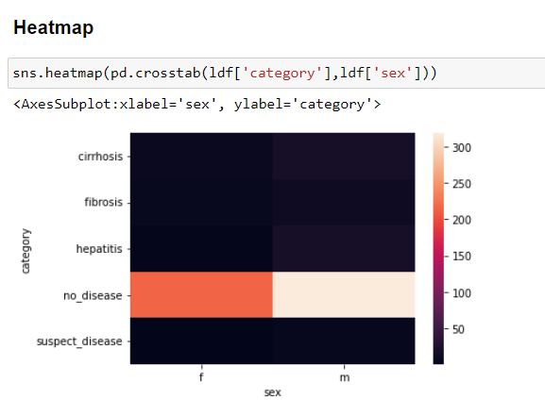

Slide 13
FEATURE ENGINEERING

Slide 14
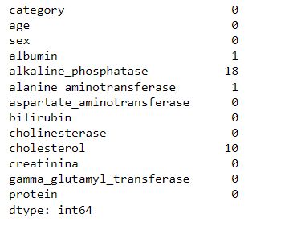
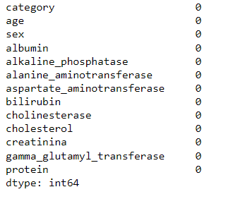
HANDLING MISSING VALUES

Slide 15
Outliers Detection and Removal
As in our dataset each features had many outliers.
We have detected the outliers by plotting the boxplot and removed the outliers by the process of capping
As capping doesn’t lose any our data

Slide 16
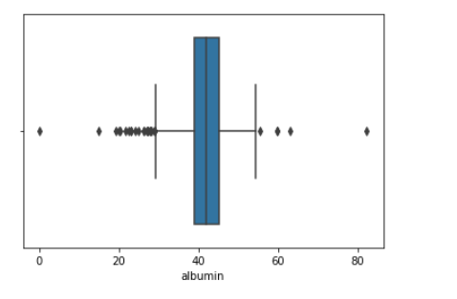
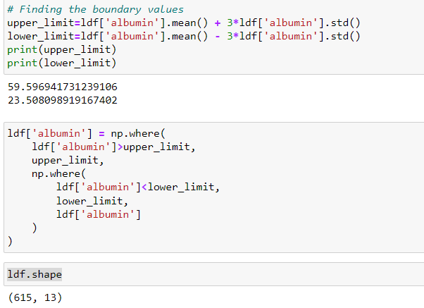

Slide 17
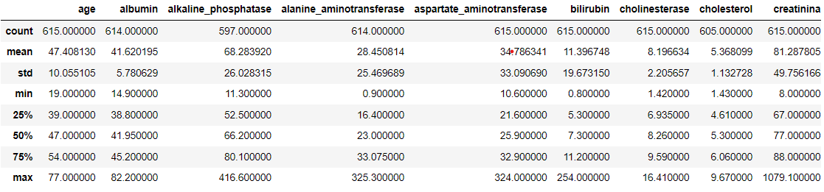
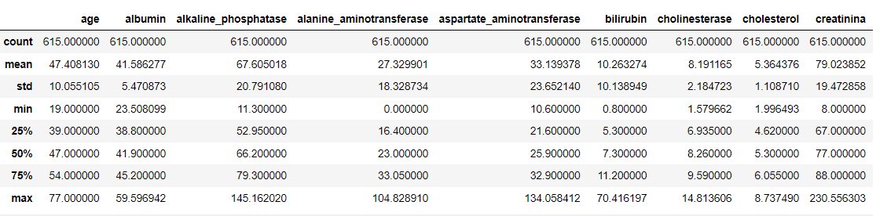

Slide 18
Converting categorical variables to numerical variables
The 2 columns sex and category columns need to converted.
Column ‘sex’ is converted using normal process.
Column ‘category is converted using label encoding.
Before converting we have first performed train_test_split
where x_train as all features and y_train as target variable
which is category column.

Slide 19
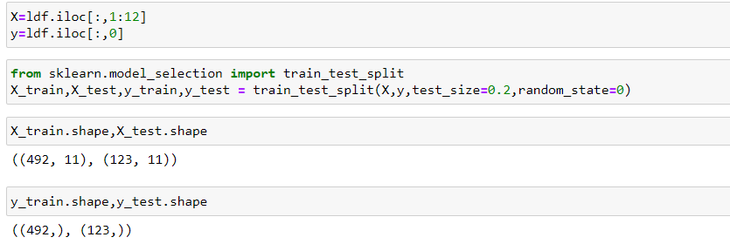
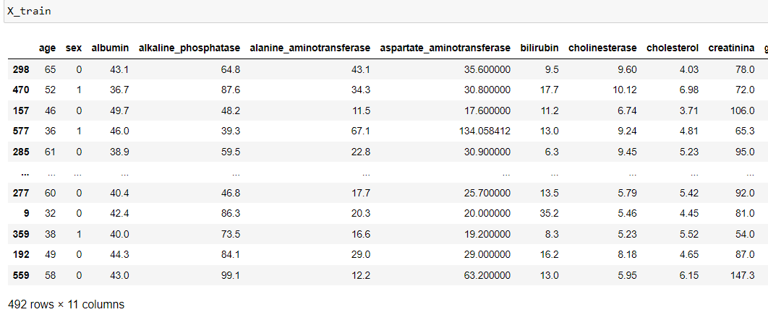

Slide 20
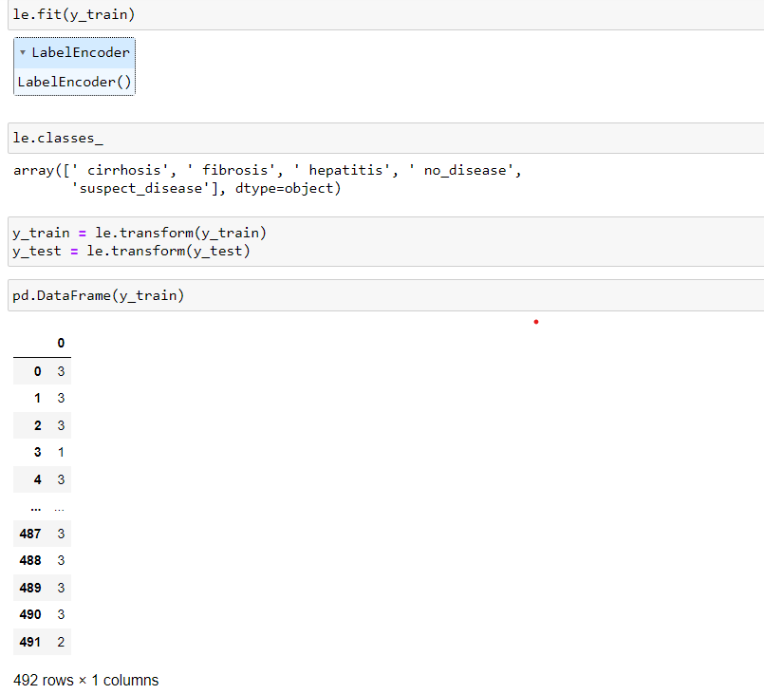

Slide 21
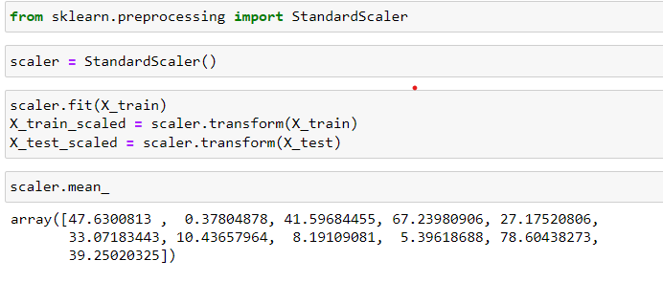
feature scaling
We have done standardization on ours by applying standard scaler.
Standardization involves transforming the features such that they have a mean of zero distribution about 68% of values lie b/w -1 to 1.

Slide 22
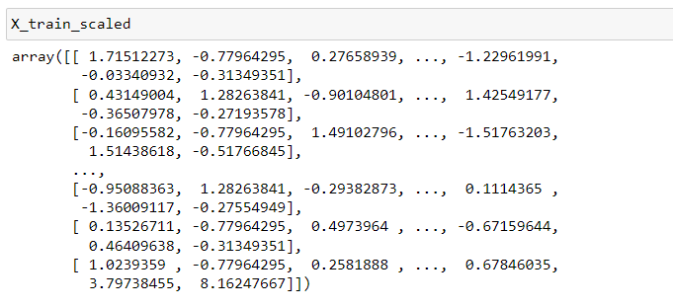
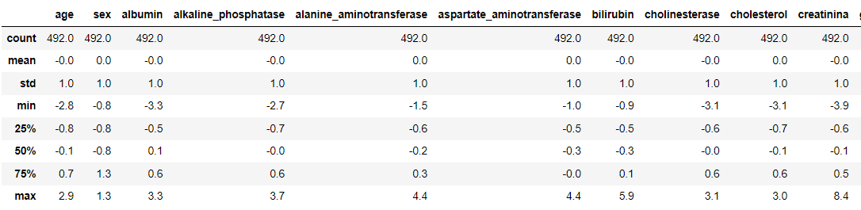

Slide 23
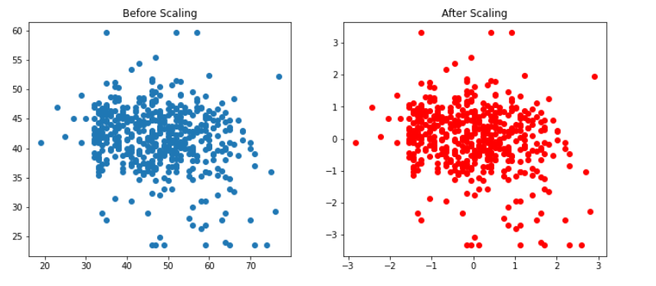
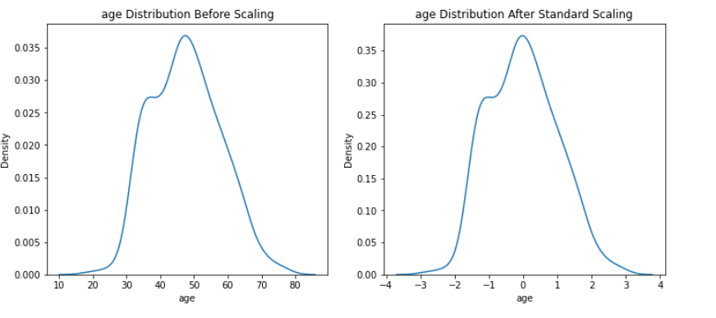
Effect of scaling

Slide 24
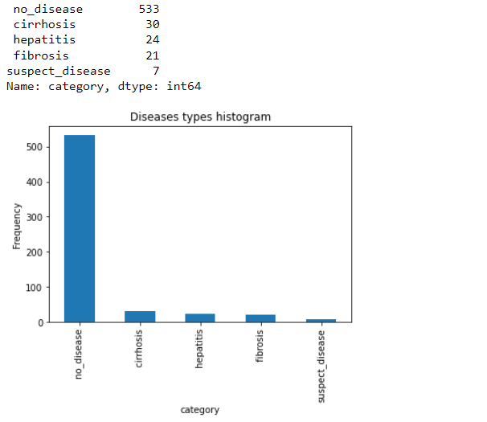
HANDLING IMBALANCED DATA

Slide 25
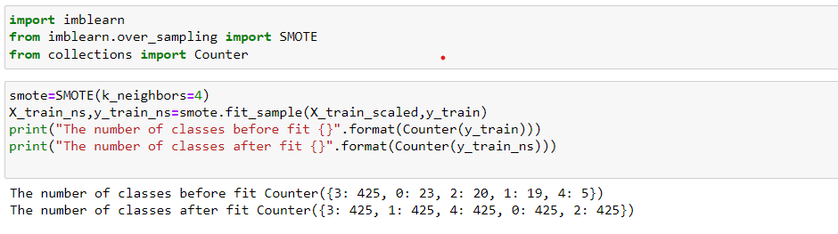
WE HAVE APPLIED THE SMOTE METHOD FOR HANDLING THE IMBALANCED CATEGORICAL DATA.

Slide 26
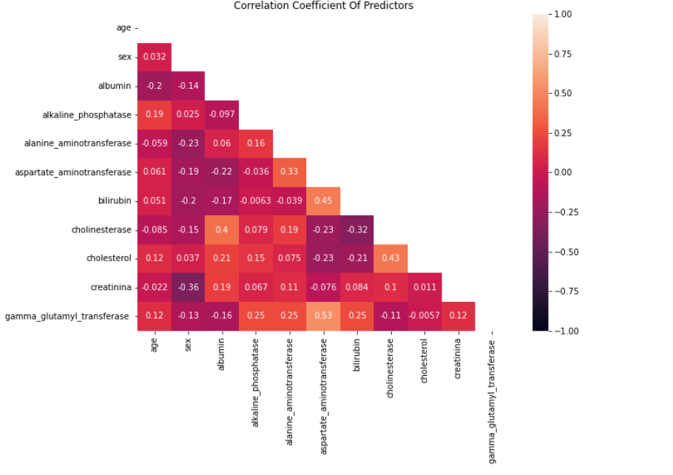
CHECKING FOR MULTICOLLINEARITY
Hence there is no multicollinearity. As any features with a correlation coefficient exceeding 0.80 are suspected of causing multicollinearity.

Slide 27
MODEL BUILDING

Slide 28
MODELS TRAINED
1) Logistic regression.
2) Random forest.
3) SUPPORT VECTOR MACHINES(SVM).
4) XG BOOST.
5) NEURAL NETWORKS.

Slide 29
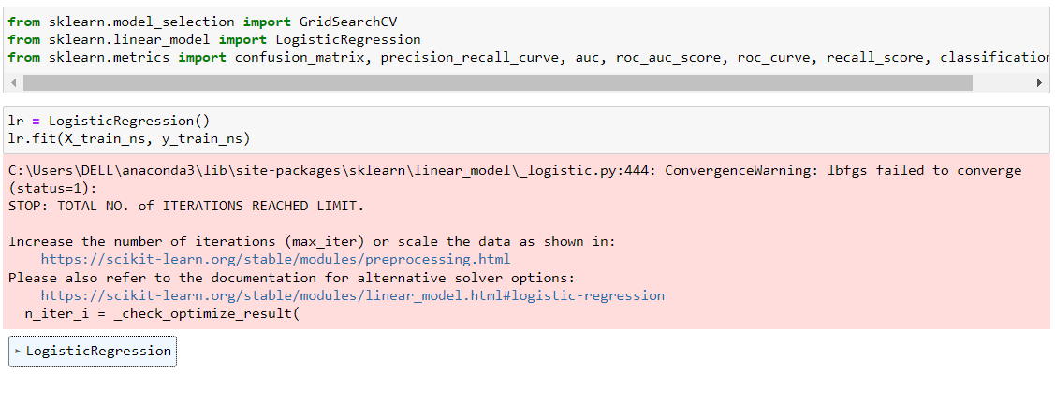

Slide 30
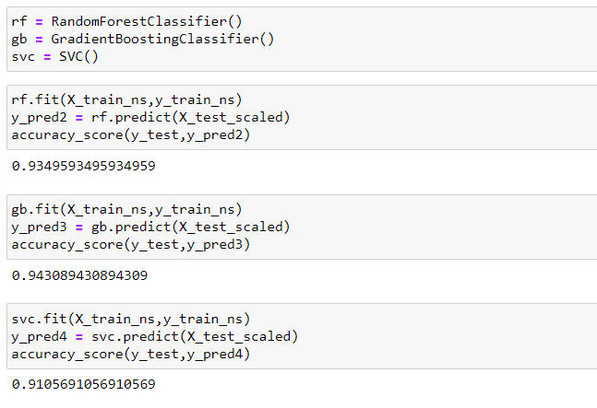

Slide 31
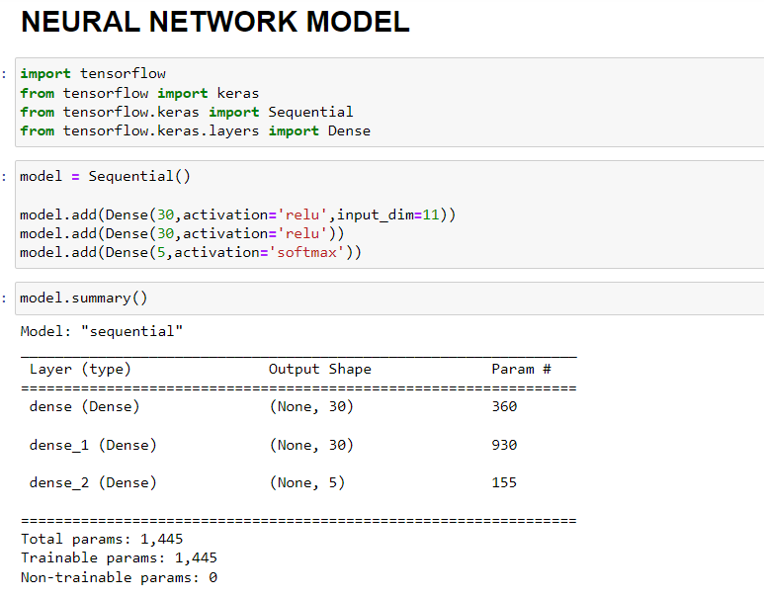
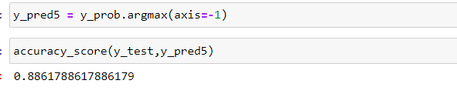

Slide 32
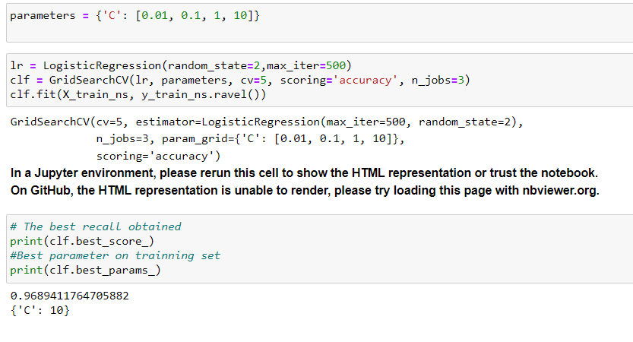
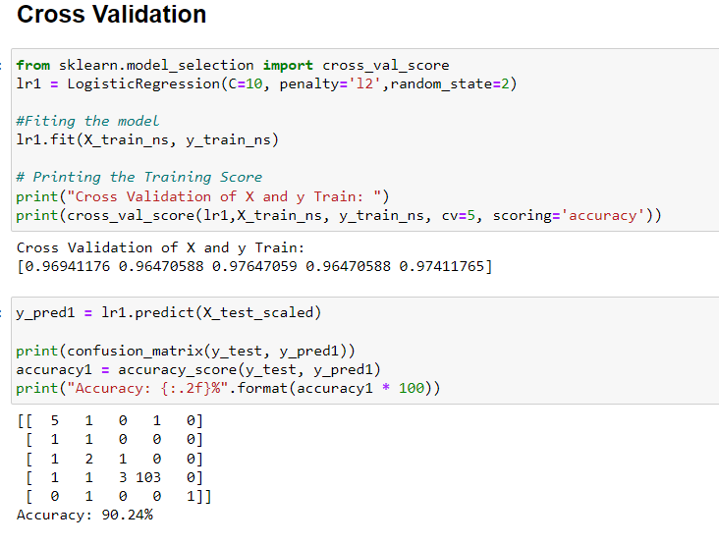
MODEL EVALUATION AND TUNING
1)Logistic Regression

Slide 33
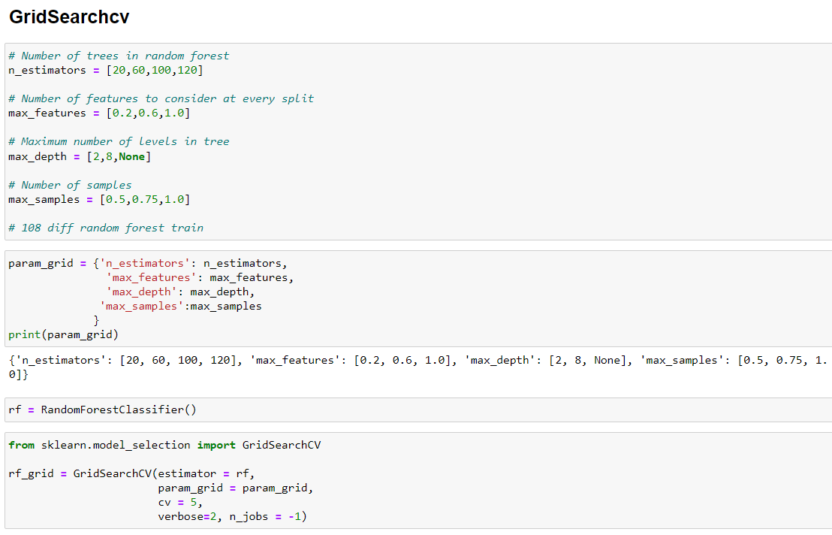
2)RANDOM FOREST

Slide 34
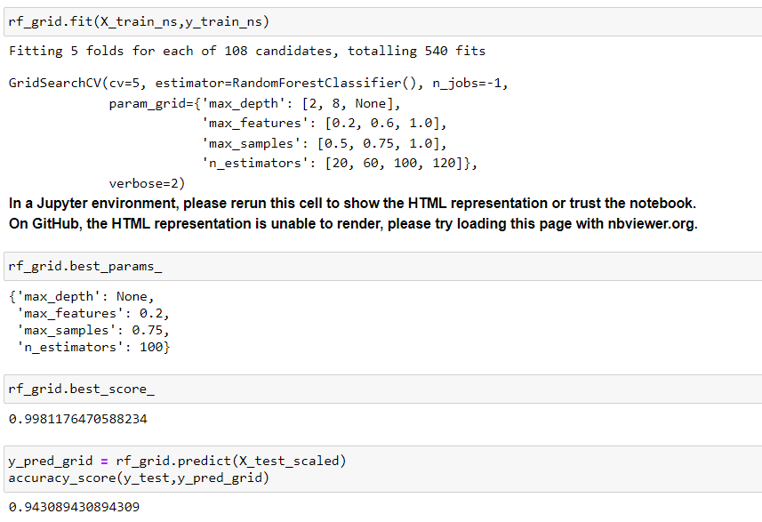

Slide 35
MODEL COMPARISION
MODEL NAME | ACCURACY SCORE
1) LOGISTIC REGRESSION | 90.24%
2) RANDOM FOREST | 93.49%
3) XG BOOST | 94.30%
4) SUPPORT VECTOR MACHINES(SVM) | 91.05%
5) NEURAL NETWORKS | 88.61%
OUT OF ALL THE MODEL RANDOM FOREST DID A BETTER JOB IN PREDICTING THE DISEASES.

Slide 36
MODEL DEPLOYMENT

Slide 37
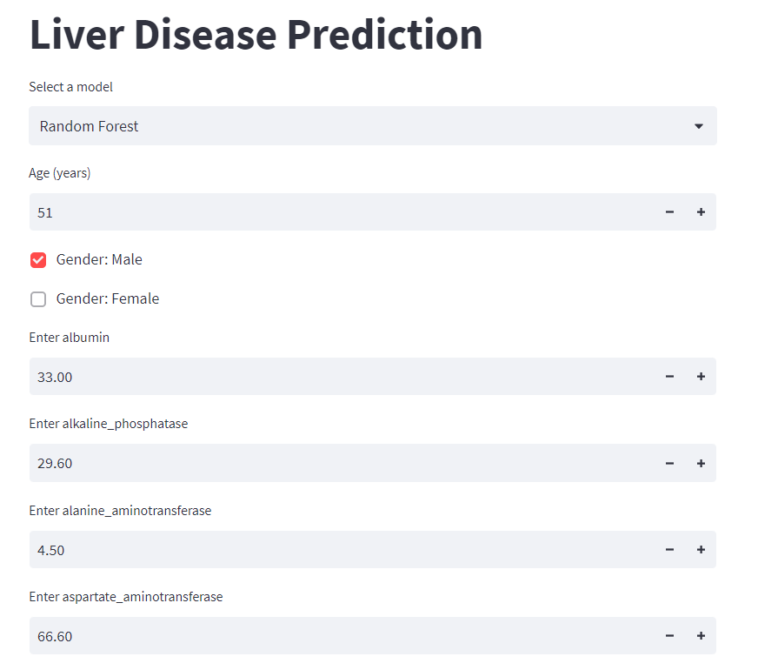

Slide 38
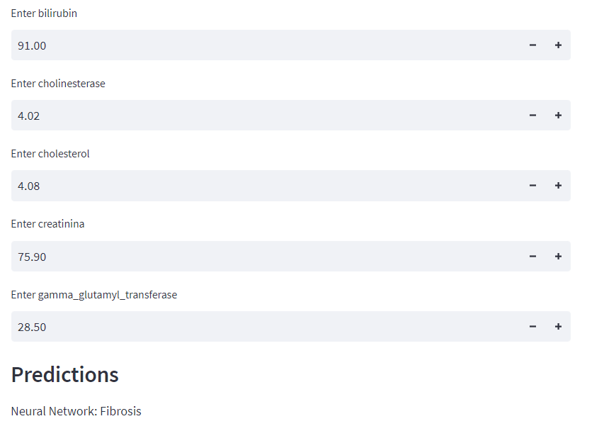

Slide 39
THANK YOU

